Slide 1
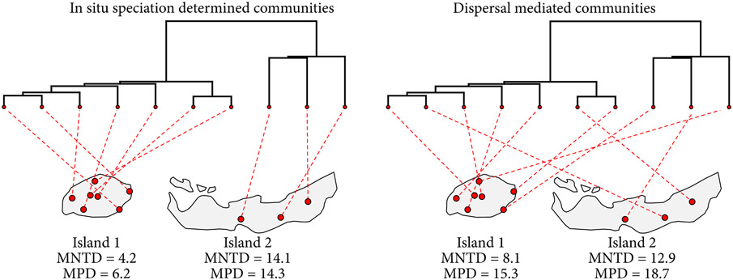



Evaluating the contribution of dispersal to community structure in Neotropical passerine birds
Notes:
Example of how two metrics of community structure, mean nearest taxon distance (MNTD) and mean pairwise distance (MPD), are affected in two hypothetical island communities of equal species richness depending on whether in situ speciation or geographic dispersal predominantly shapes community structure.
IF THIS IMAGE HAS BEEN PROVIDED BY OR IS OWNED BY A THIRD PARTY, AS INDICATED IN THE CAPTION LINE, THEN FURTHER PERMISSION MAY BE NEEDED BEFORE ANY FURTHER USE. PLEASE CONTACT WILEY'S PERMISSIONS DEPARTMENT ON PERMISSIONS@WILEY.COM OR USE THE RIGHTSLINK SERVICE BY CLICKING ON THE 'REQUEST PERMISSIONS' LINK ACCOMPANYING THIS ARTICLE. WILEY OR AUTHOR OWNED IMAGES MAY BE USED FOR NON-COMMERCIAL PURPOSES, SUBJECT TO PROPER CITATION OF THE ARTICLE, AUTHOR, AND PUBLISHER.

Slide 2
Evaluating the contribution of dispersal to community structure in Neotropical passerine birds
Notes:
Example of how two metrics of community structure, mean nearest taxon distance (MNTD) and mean pairwise distance (MPD), are affected in two hypothetical island communities of equal species richness depending on whether in situ speciation or geographic dispersal predominantly shapes community structure.
IF THIS IMAGE HAS BEEN PROVIDED BY OR IS OWNED BY A THIRD PARTY, AS INDICATED IN THE CAPTION LINE, THEN FURTHER PERMISSION MAY BE NEEDED BEFORE ANY FURTHER USE. PLEASE CONTACT WILEY'S PERMISSIONS DEPARTMENT ON PERMISSIONS@WILEY.COM OR USE THE RIGHTSLINK SERVICE BY CLICKING ON THE 'REQUEST PERMISSIONS' LINK ACCOMPANYING THIS ARTICLE. WILEY OR AUTHOR OWNED IMAGES MAY BE USED FOR NON-COMMERCIAL PURPOSES, SUBJECT TO PROPER CITATION OF THE ARTICLE, AUTHOR, AND PUBLISHER.

Slide 3
Evaluating the contribution of dispersal to community structure in Neotropical passerine birds
Notes:
Example of how two metrics of community structure, mean nearest taxon distance (MNTD) and mean pairwise distance (MPD), are affected in two hypothetical island communities of equal species richness depending on whether in situ speciation or geographic dispersal predominantly shapes community structure.
IF THIS IMAGE HAS BEEN PROVIDED BY OR IS OWNED BY A THIRD PARTY, AS INDICATED IN THE CAPTION LINE, THEN FURTHER PERMISSION MAY BE NEEDED BEFORE ANY FURTHER USE. PLEASE CONTACT WILEY'S PERMISSIONS DEPARTMENT ON PERMISSIONS@WILEY.COM OR USE THE RIGHTSLINK SERVICE BY CLICKING ON THE 'REQUEST PERMISSIONS' LINK ACCOMPANYING THIS ARTICLE. WILEY OR AUTHOR OWNED IMAGES MAY BE USED FOR NON-COMMERCIAL PURPOSES, SUBJECT TO PROPER CITATION OF THE ARTICLE, AUTHOR, AND PUBLISHER.

Slide 4
